Slide 1
SensorLogger實作
Jordan
Department of Computer Science
National Chiao Tung University

Slide 2
大綱
Time | Topic | Content
9:00 – 9:30 | Android lifecycle | Start an Android app
9:30 – 10:00 | UI design | Create UI
10:00 – 10:30 | SharedPreference & Permission | Set up before coding
10:30 – 10:45 | Break time | Take a break
10:45 – 11:15 | Access GPS & sensor | Coding
11:15 – 11:45 | Button control | Coding
11:45 – 12:00 | Q&A | Discuss with TA

Slide 3
Android Activity Lifecycle
Active(活動)
Paused(暫停)
Stopped(停止)
Dead/Inactive(已回收或未啟動)
Notes:
Activity: User Interface program，提供使用者互動式介面，所有Activity由Activity Stack管理，當新的Activity被執行後，會放到stack最頂端，並且變成running activity
一個Activity基本上有四個狀態 Active, Paused, Stopped, Dead: Active (活動): Active狀態是使用者啟動Application 或 Activity 後，Activity 在運行中的狀態. 在 Android 平台上, 一個時刻只會有一個 Activity 處於Active 或 Running 狀態。其他的 Activity 都處於未Dead, Stopped 或是Paused 的狀態.
Paused (暫停) Paused狀態是當 Activity 暫時暗下來, 退到背景畫面的狀態. 例如當電話來時, 原本運行的 Activity 退到背景畫面. 新出現的介面元件蓋住了原來的 Activity 畫面.
Activity 處在Paused狀態時, 使用者無法與原來的 Activity 互動. Stopped (停止) Stopped狀態是有其他 Activity 正在執行, 而這個 Activity 已經離開螢幕, 不再動作的狀態. 透過長按Home鍵, 可以叫出所有處於Stopped狀態的Application List(應用程式列表). 在Stopped狀態的 Activity，還可以透過 Notification 來喚醒。以後再說明 Notification.
Dead/Inactive (已回收或未啟動) Dead狀態是 Activity 尚未被啟動, 已經被手動終止, 或已經被系統回收的狀態. 要手動終止 Activity, 可以在程式中呼叫 finish 函式. 如果是被系統回收, 可能是因為記憶體不足, 系統根據記憶體不足時的回收規則, 將處於Stopped狀態的 Activity 所佔用的記憶體回收.

Slide 4
Android Activity Lifecycle
Notes:
1. Entire lifetime: 一個Activity的Entire lifetime是由onCreate()開始, 一直到onDestroy()結束.
一個Activity可以把所有的資源設定寫在onCreate中, 一直到onDestroy()時再釋放出來. 2. Visible lifetime: 一個Activity的Visible lifetime是指在onStart()到onStop()之間.
在這段時間內，使用者可以在螢幕上看見Activity, 要注意這個"Visible"是個形容, Activity不見得一定在foreground(前景)跟使用者直接互動. 3. Foreground lifetime: 一個Foreground lifetime 指 onResume() 到 onPause() 之間. 這個時期的Activity是在其他的Activity的前面, 且可以直接跟使用者進行互動. 所以這段時期指的就是圖中的Activity is running.
onCreate()用來做程式的初使化動作; onDestory()通常都拿來把onCreate()時的資料做釋放的動作;
onPause()時把需要保存的資料保存; onResume()把保存的資料拿回來使用.

Slide 5
Lab Goal

Slide 6
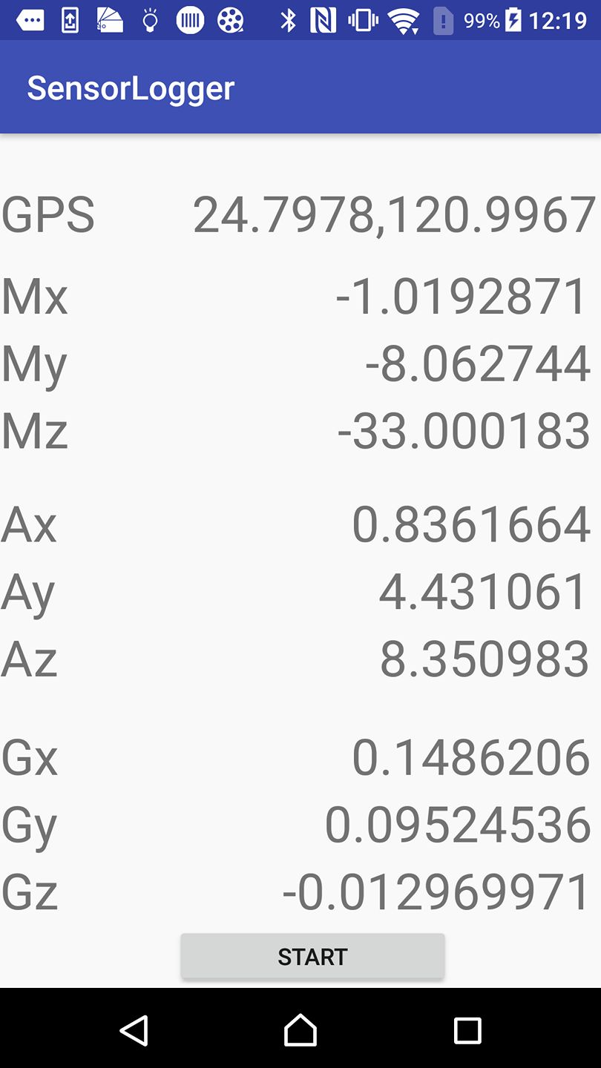
Goal
UI design
Load GPS value
Load Magnitude value
Load Accelerator value
Load Gyro value
Create a control button

Slide 7
How to create a new android project?

Slide 8
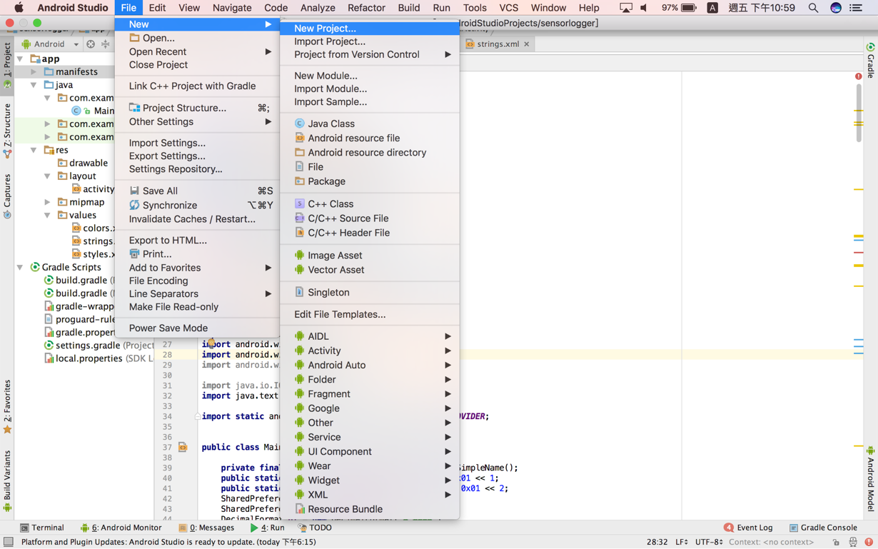
New project
Start Android Studio
File -> New -> New project

Slide 9
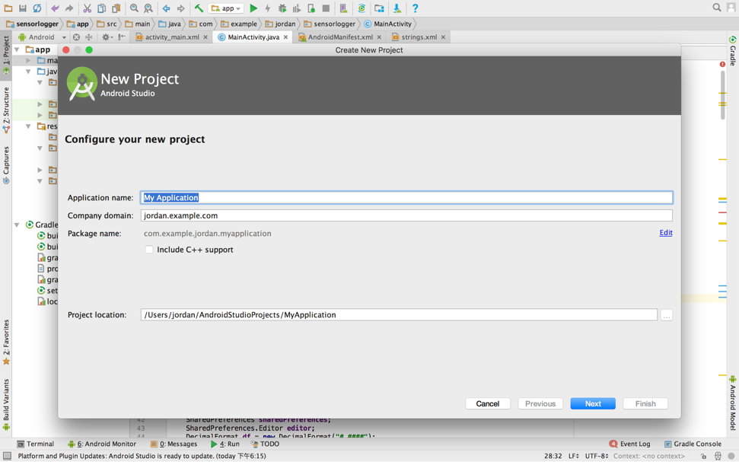
Set up Application name
You can set up your app name here.
When you execute this app, app name will be shown on monitor.

Slide 10
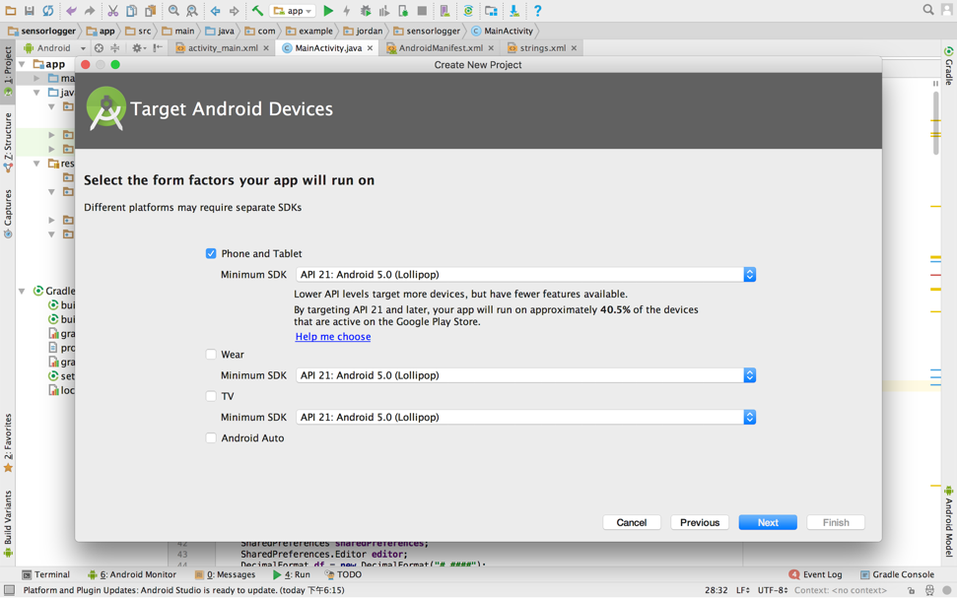
Choose minimum SDK
Select Phone and Tablet
Select minimum SDK
API above 21 is recommended

Slide 11
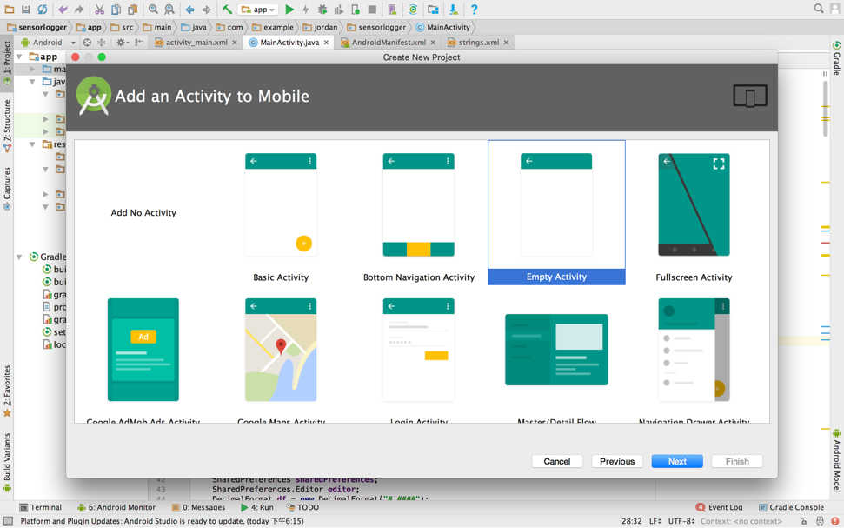
Start with empty activity
Multiple template here
Select empty activity
We design our own

Slide 12
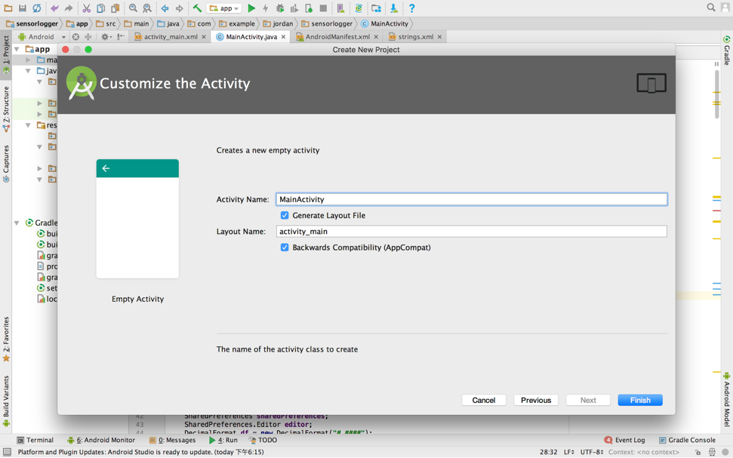
Activity name & Layout name
Set up Activity name and layout name here

Slide 13
UI design

Slide 14
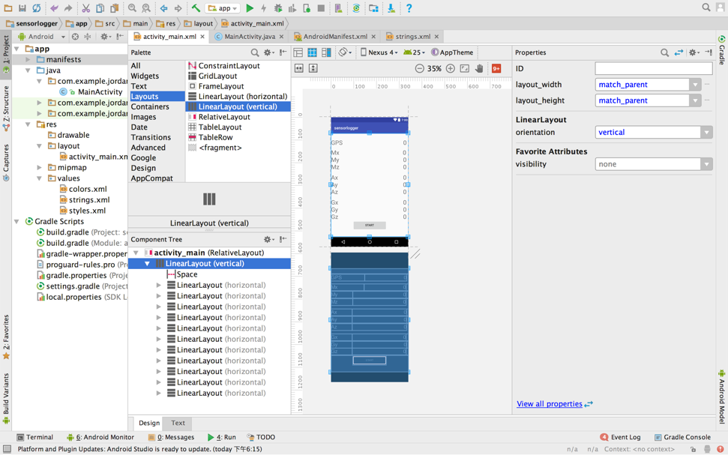
More reliable layout
App -> res -> layout -> activity_main.xml
Layouts -> LinearLayout(vertical)

Slide 15
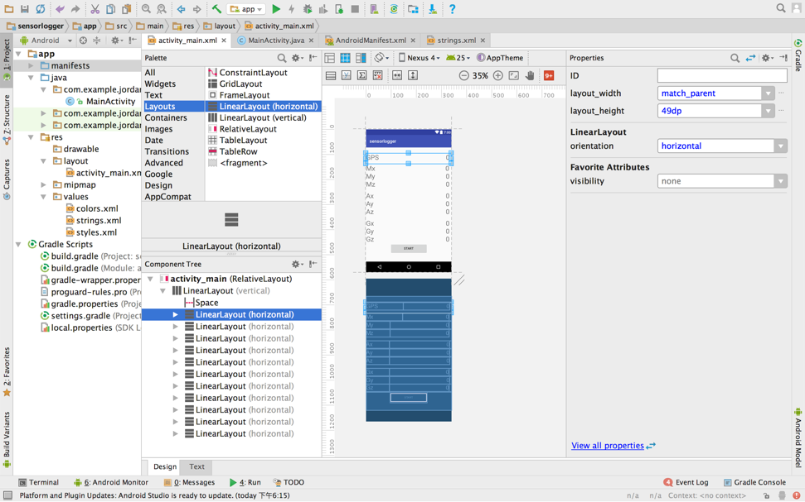
Divide into several blocks
Under vertical linear layout
Use LinearLayout(horizontal) to divide scene into several blocks

Slide 16
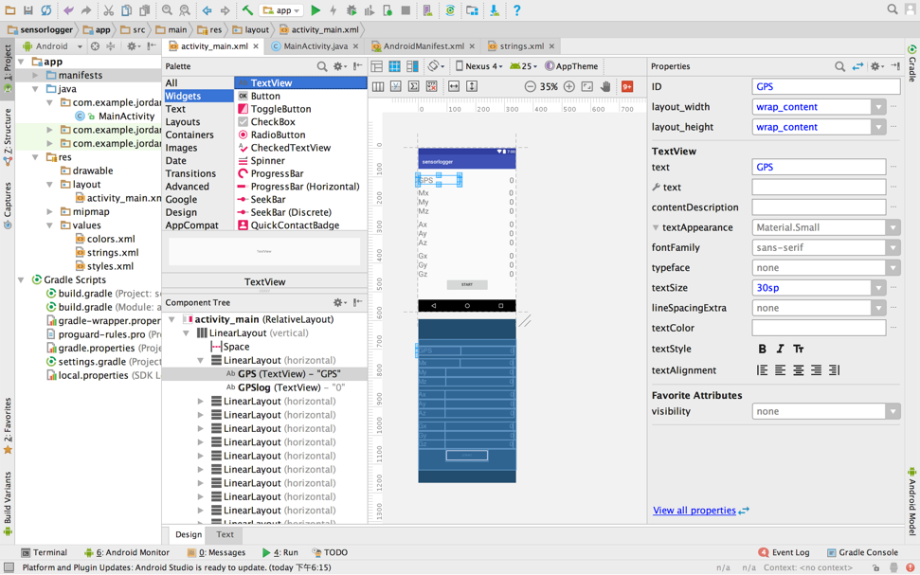
Put TextView(1)
Widgets -> TextView
Under each horizontal linear layout
Put TextView on lefthand side
To show title
You may edit properties

Slide 17
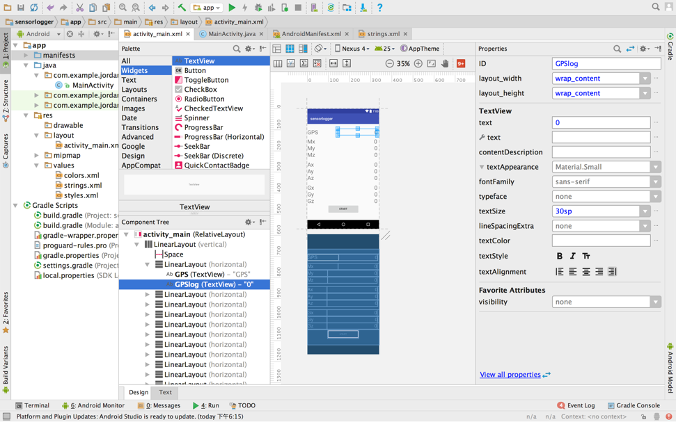
Put TextView(2)
Put TextView on righthand side
To show value

Slide 18
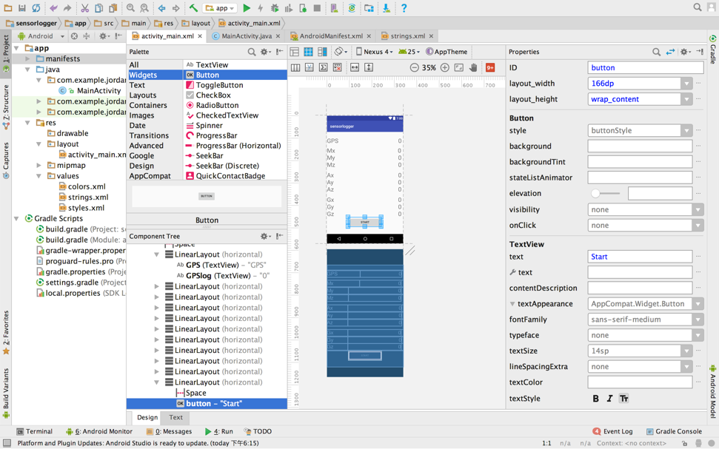
Put button
Widgets -> Button
Set Button’s text as “Start”

Slide 19
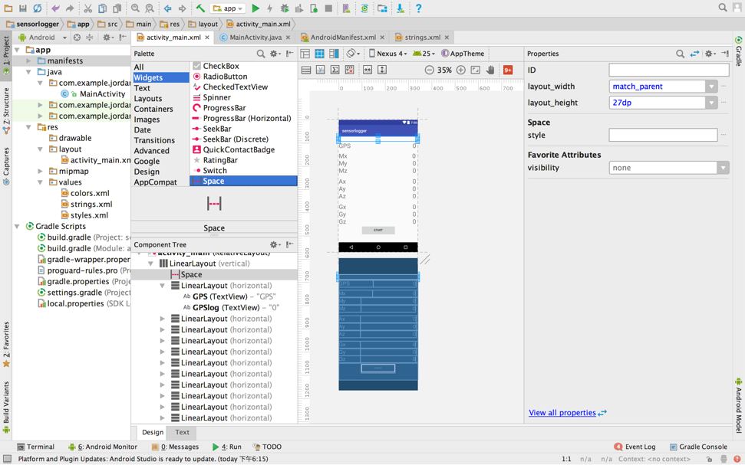
Insert space
Widgets -> Space
Insert space to make your UI perfect

Slide 20
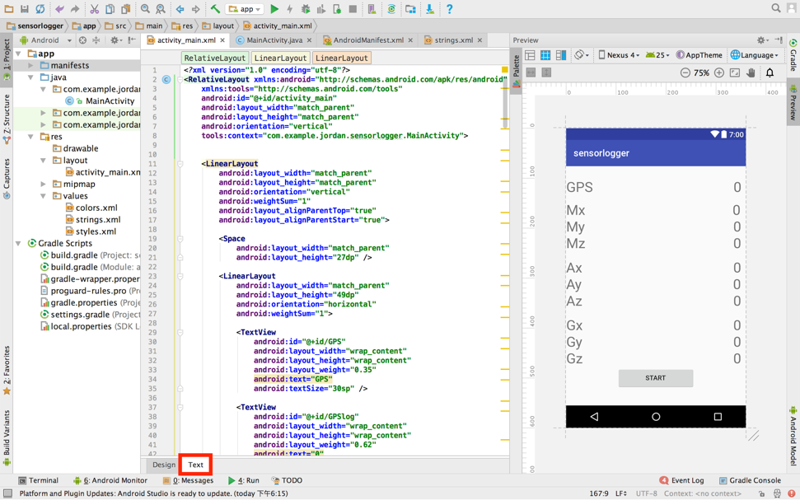
Edit UI by code
If you feel “drag” is not convenient, you can edit it using code

Slide 21
Shared preferences

Slide 22
Brief
To store data with key & value
To avoid data missing after exiting process
We store data into shared preferences

Slide 23
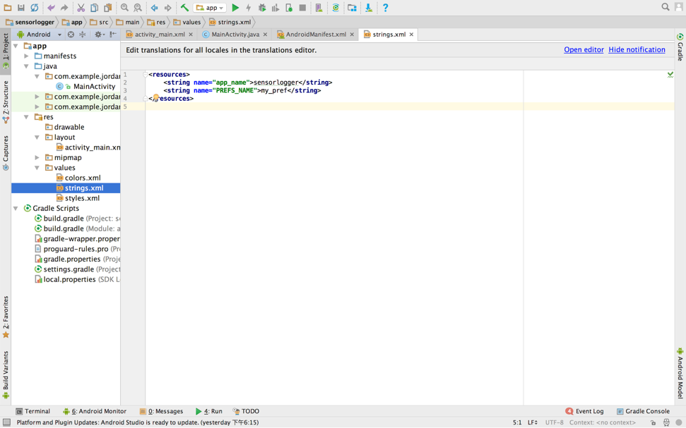
Set up preference name
App -> res -> values -> strings.xml

Slide 24
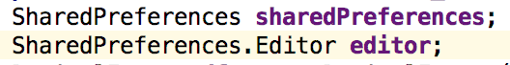
Declare SharedPreference
Declare SharedPreferences as global variable
Declare Editor

Slide 25
Get SharedPreferences
In onCreate(), get shared preferences with preference name
And edit shared preference

Slide 26
Import library
If some parameter or datatypes are showed in red
Use Alt + Enter to automatically import library

Slide 27
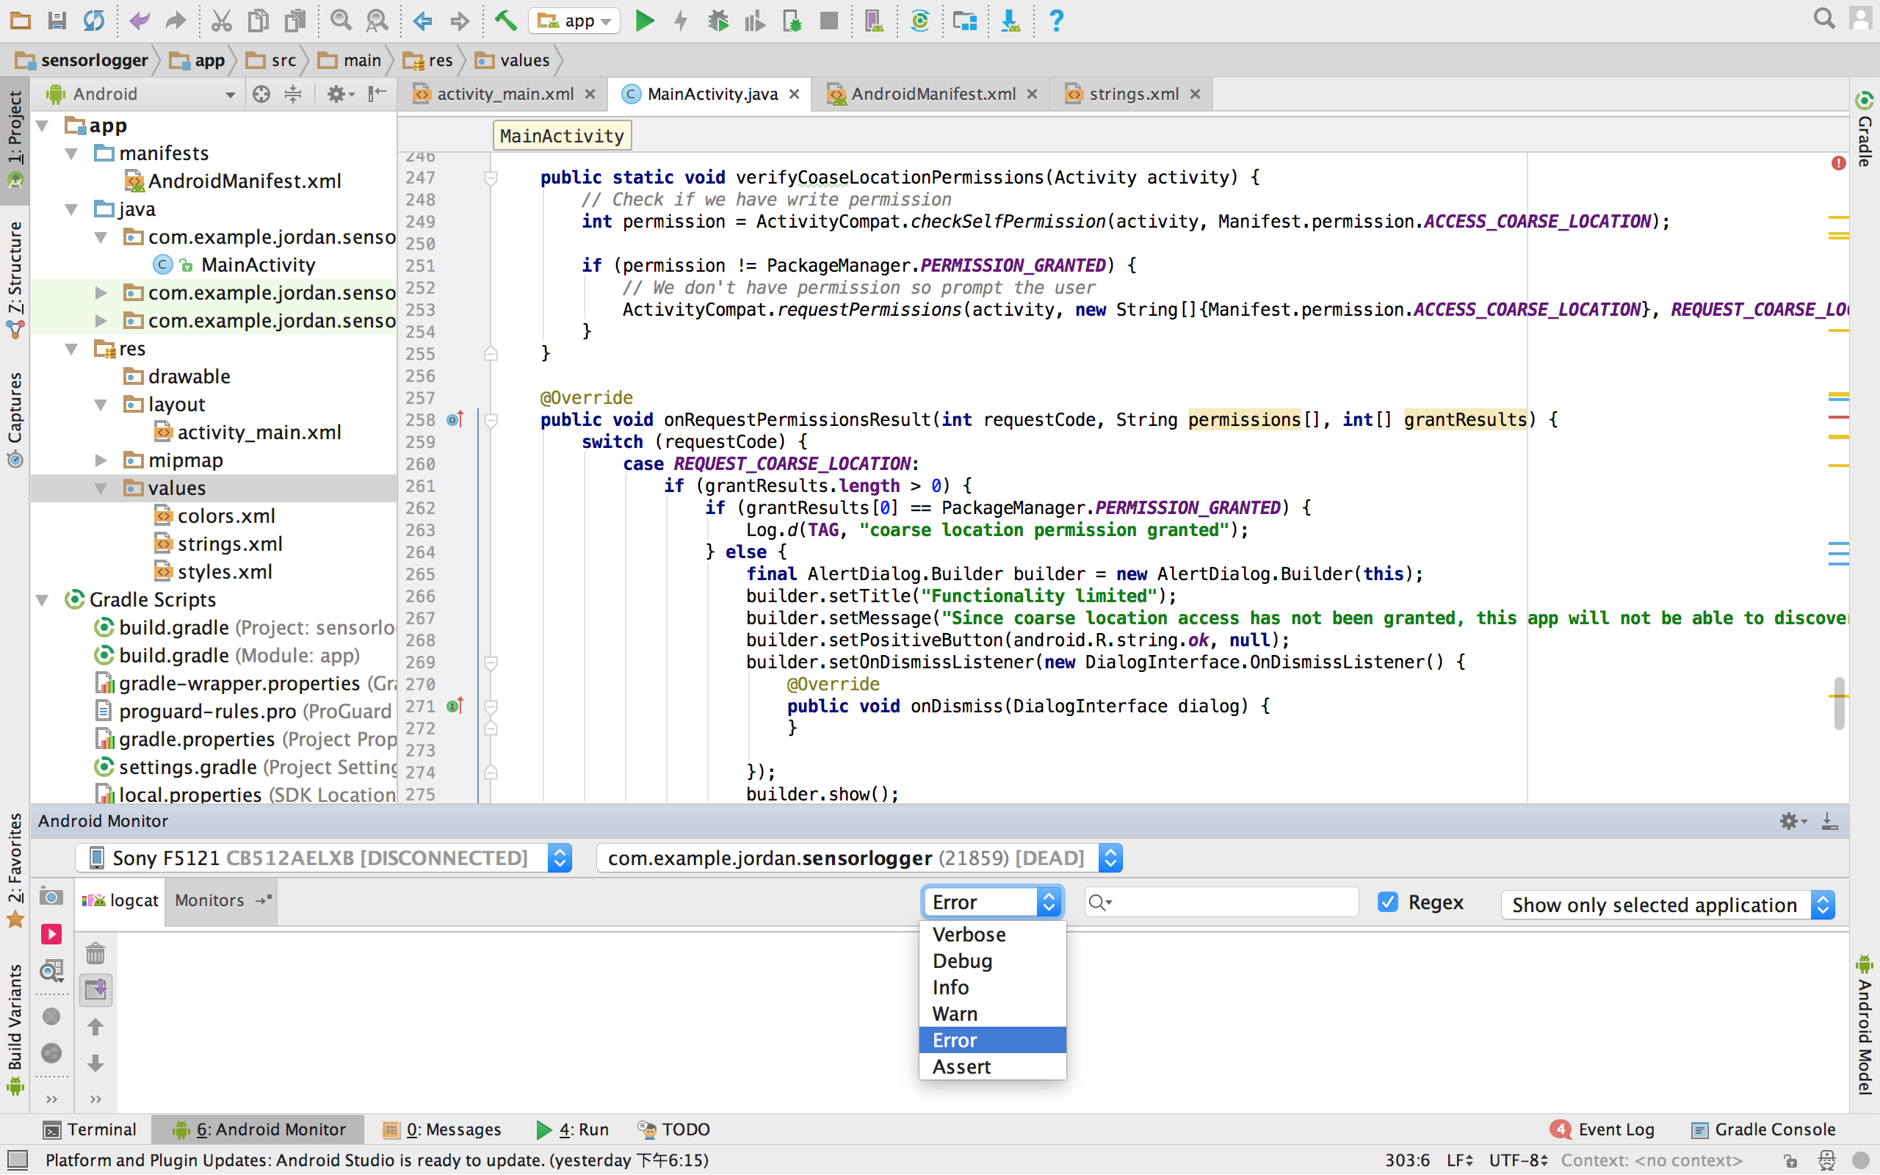
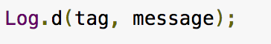
Debug tool
Log
Toast

Slide 28
User premission

Slide 29
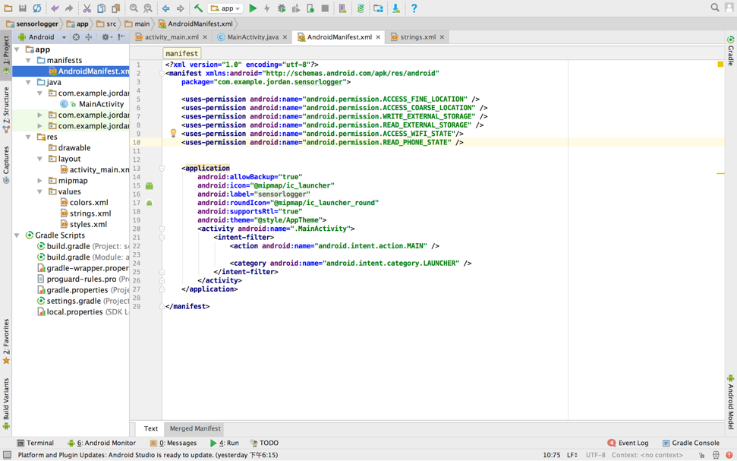
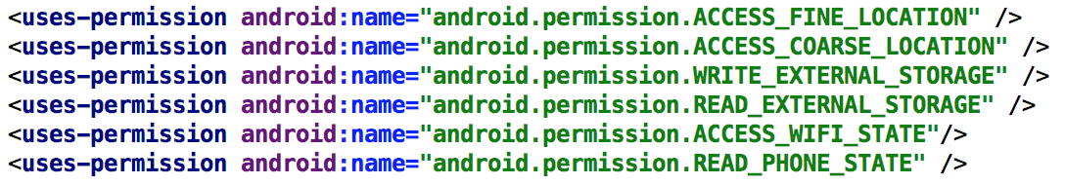
Android manifest
App -> manifests -> AndroidManifest.xml
Add GPS permission

Slide 30
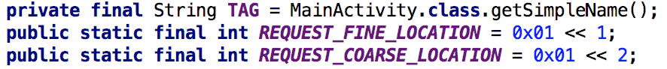
Permission request
Define three variables as global variables
Write a function which can pop up alert dialog

Slide 31
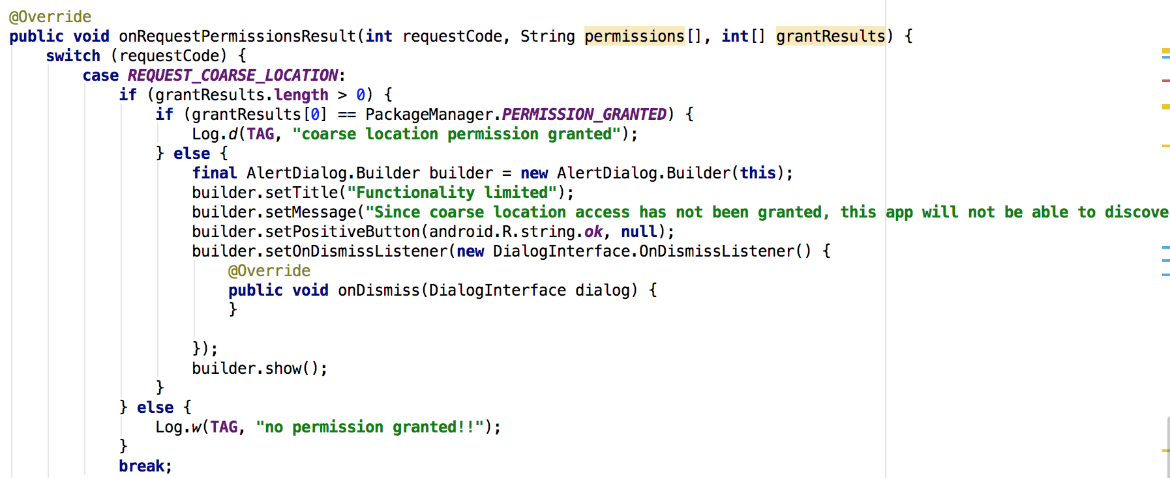
Permission request

Slide 32
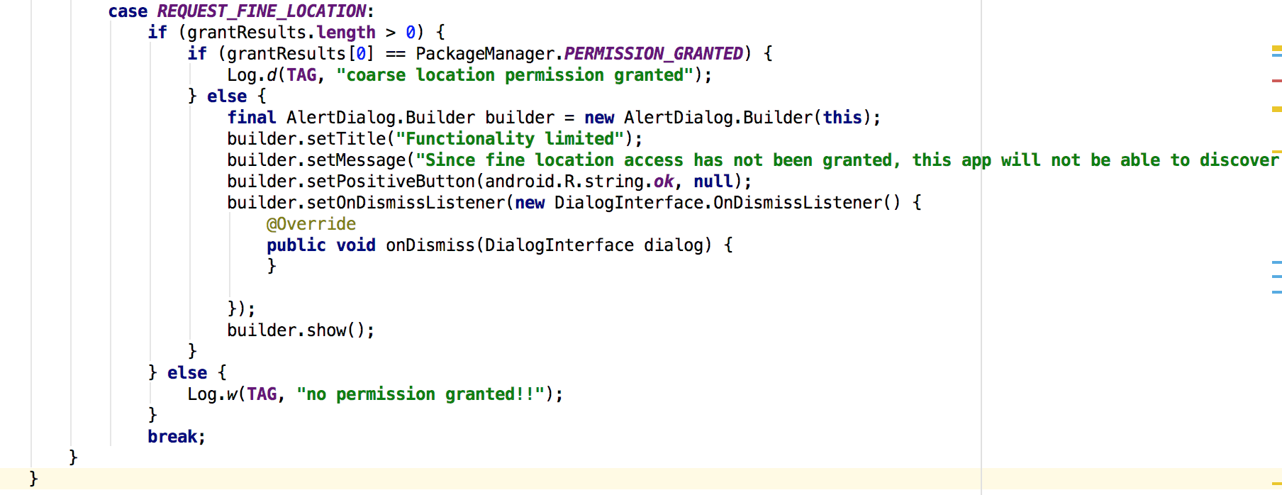
Permission request

Slide 33
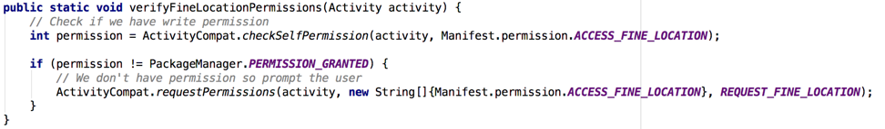
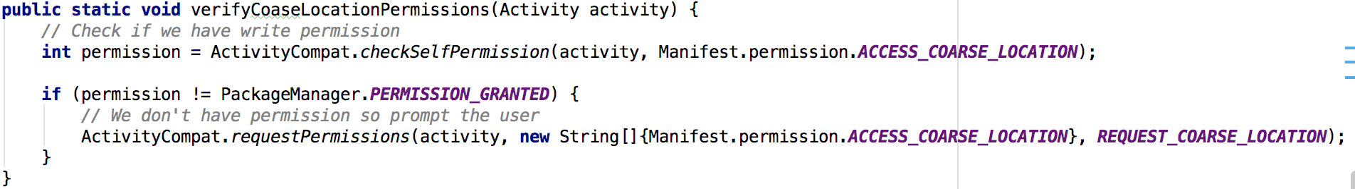
Notify user to turn on permission
Write two function to notify user to turn on permission

Slide 34
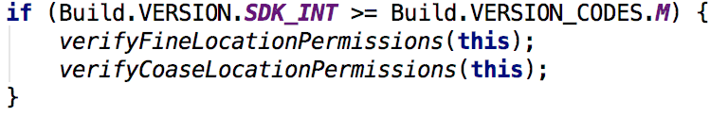
Call these function in onCreate()

Slide 35
Connect UI

Slide 36
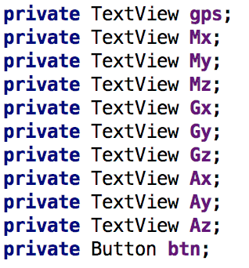
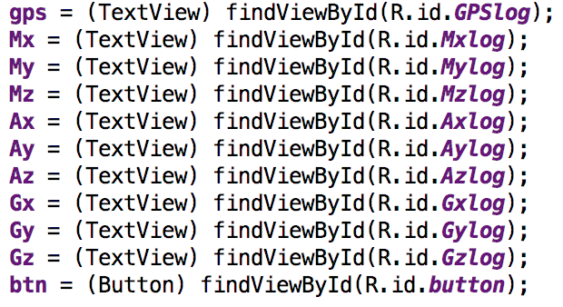
Declare & Find view by id
Declare UI component with there types
Find view by id in onCreate()

Slide 37
Access GPS

Slide 38
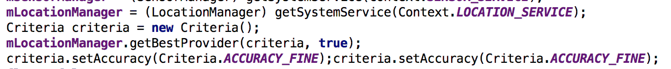
Location Manager
Declare location manager as a global variable
Assign criteria in onCreate()

Slide 39
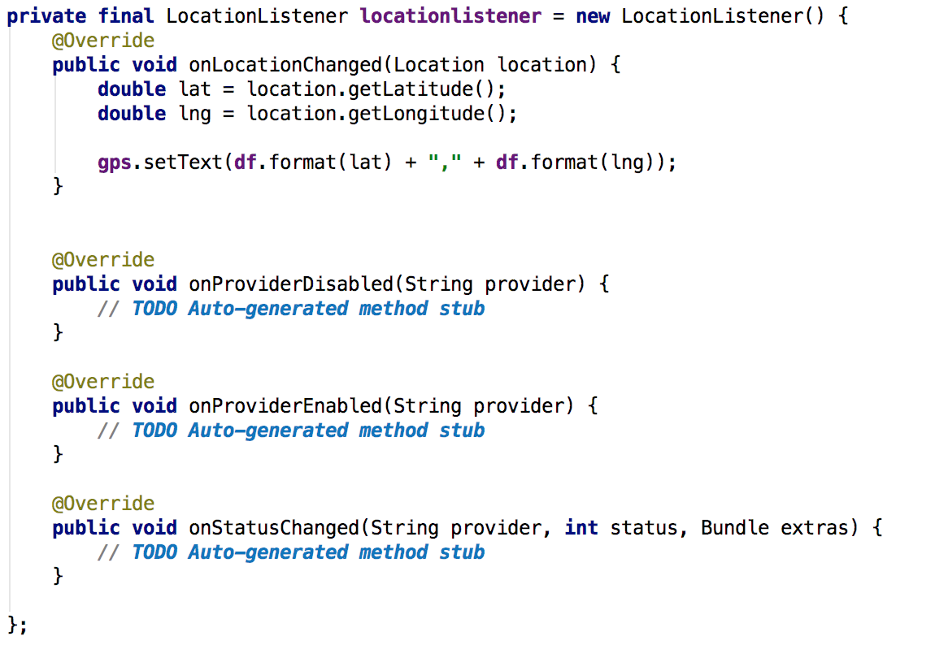
Location Listener
Declare a global location listener
Limit show up format using DecimalFormat

Slide 40
Access Sensor

Slide 41
Sensor Manager
Declare sensor manager as a global variable
Declare a sensor list
SensorManager get sensor service

Slide 42
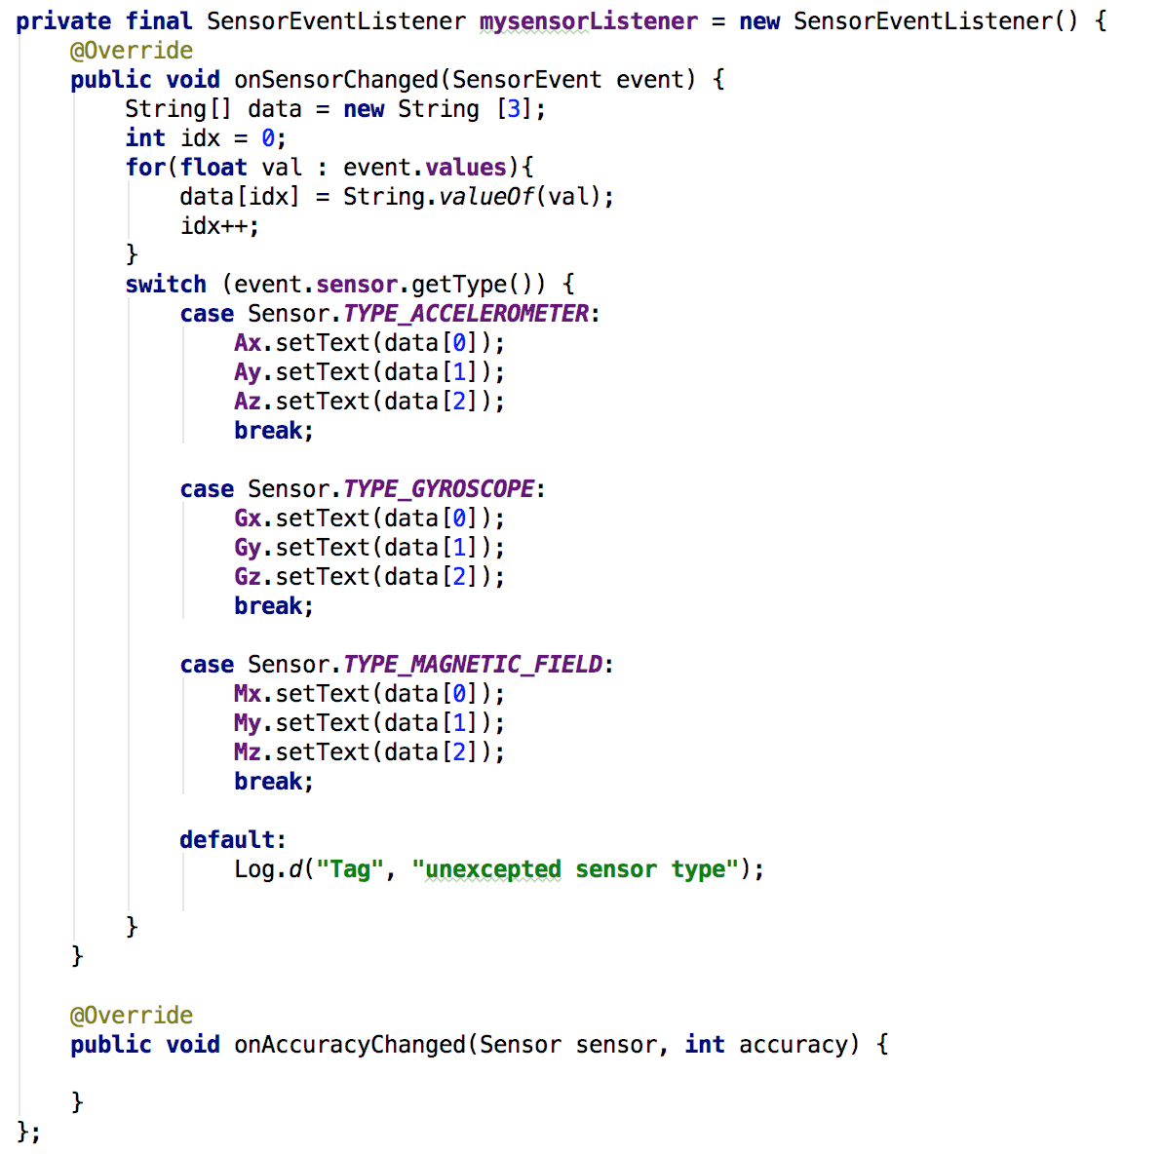
Sensor Event Listener
Declare a global SensorEventListener
Edit textview when they change

Slide 43
Button control

Slide 44
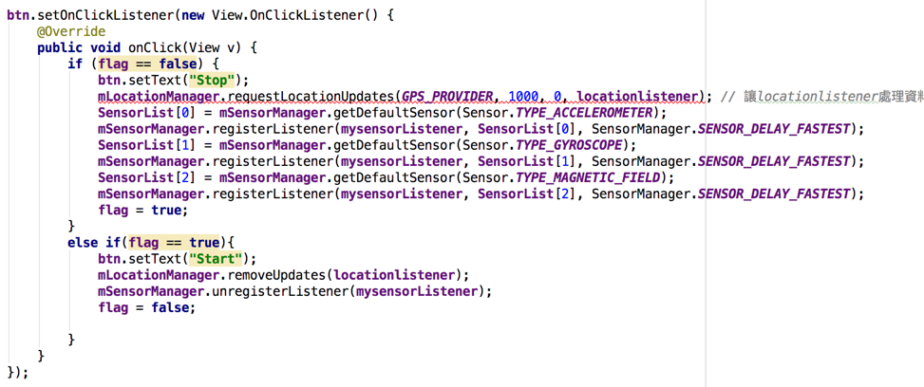
Set OnClickListener
Use a boolean to control
Set request to make location update per second
Define sensor in sensor list
Remove/unregister listener

Slide 45
Test your app

Slide 46
Advanced Lab
Service execute in background
Parallel execute on multi threads

Slide 47
Thank you

